Slide 1

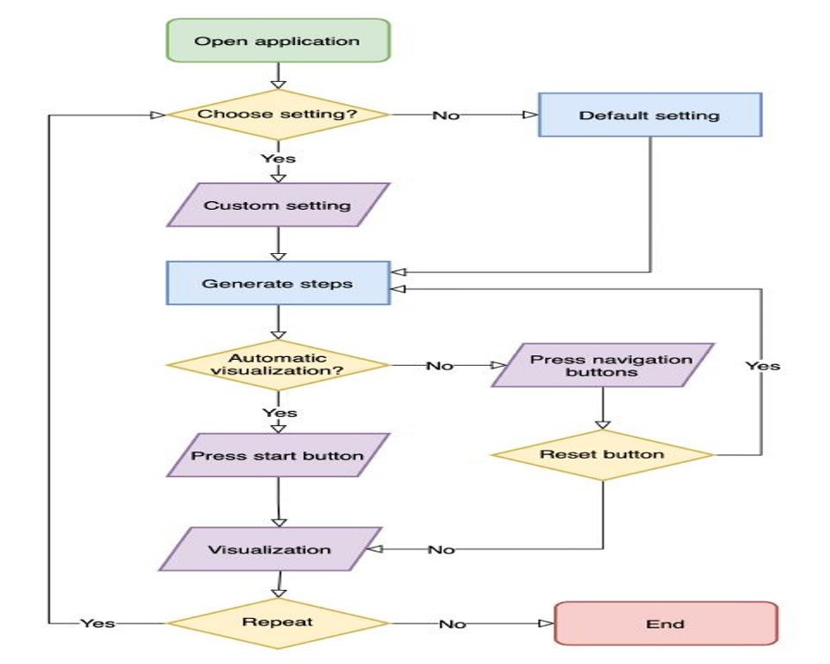
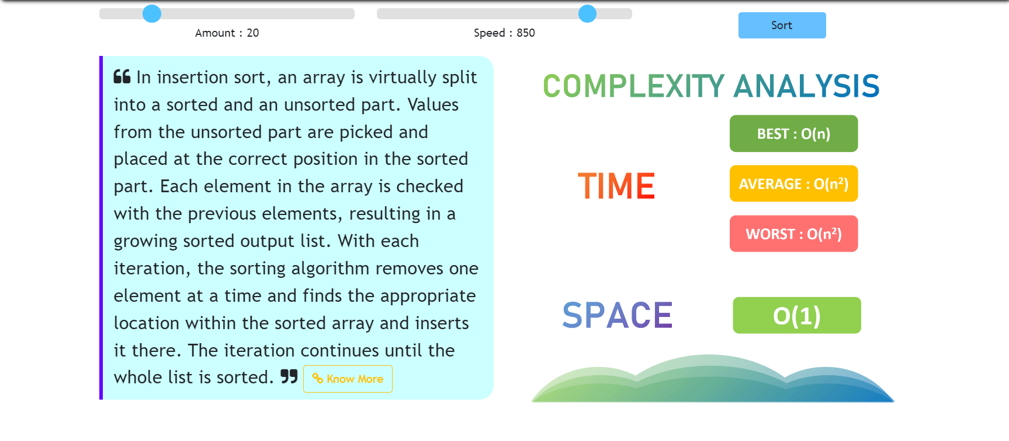
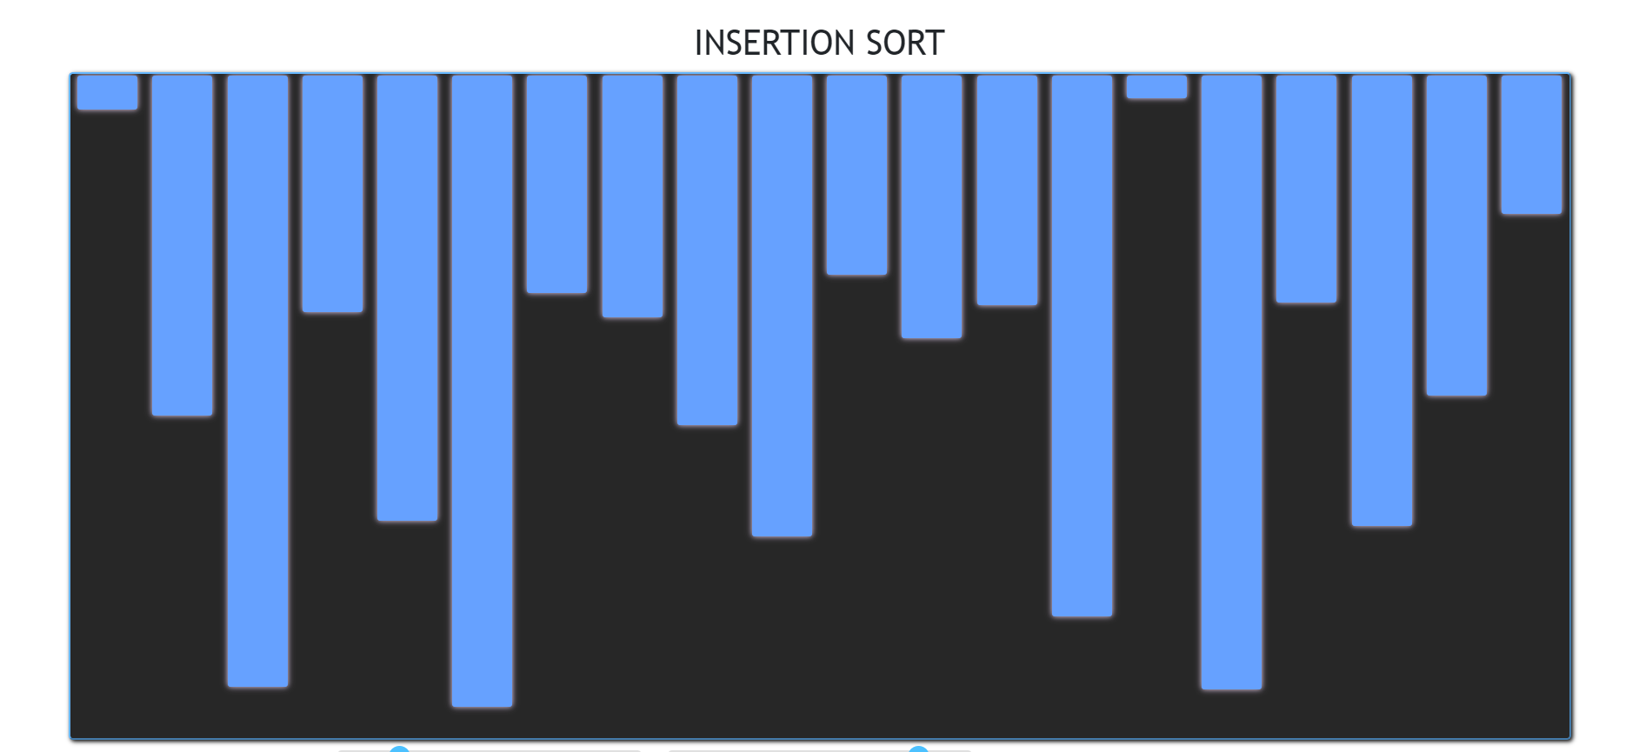
ALGO ANIMATIONS DEVELOPMENT THROUGH WEB DEVELOPMENT
Department of Computer Science & Engineering
School of Computing
1156CS701 – MAJOR PROJECT
WINTER SEMESTER 2022-2023
ABSTRACT
INTRODUCTION
RESULTS
STANDARDS AND POLICIES
Sorting visualizer is a project that involves the development of a web-based application that enables users to visualize various sorting algorithms. The application provides a graphical representation of the sorting process, which helps users to understand the working of the sorting algorithms better. This project is an excellent educational tool that helps students and developers to learn and understand various sorting algorithms such as Bubble Sort, Selection Sort, Insertion Sort, Merge Sort, Quick Sort, and many more.
The sorting visualizer project is designed to provide a fun and interactive way to learn sorting algorithms. Users can select a sorting algorithm of their choice and see the algorithm in action. The application uses an array of random numbers that are then sorted using the selected sorting algorithm. As the sorting algorithm progresses, the application displays the array at each step, providing a graphical representation of the sorting process. This helps users to visualize the changes made to the array at each step of the sorting process.
There is a growing trend in web applications of displaying the algorithms behind the data. This can be done in a couple of ways: by using charts and graphs, or by writing code that creates the visualization itself.
The Algo animations development project is a web development project which is used to visualize the sorting algorithms and performs the operation of algorithms step by step as the algorithms work like Bubble Sort, Selection Sort, Merge Sort etc... The application allows both an interactive mode as well as an automated mode by collecting the data.
When the users select the algorithm they want to view the application will run and display the information in real-time, such as the time taken to sort an array with a number of elements N using a particular algorithm. A drop down menu also allows the users to choose the data type of the array which need to be sorted.
Input
Input is usually obtained from the input parameters of numerical values
Process
The User can able to give the inputs in size and speed of the array segment.
Output
Sorting algorithms can be represented in animated ways like in the forms of graphs.
The size and speed of the adjustment features will help to demonstrate the user friendly sorting logic understandable representation.
Python Standard Used: ISO/IEC WD TR 24772-4
Anaconda-Standard Used: ISO/IEC10918-1:1994
VSCode :Visual Studio Code (VS Code) is a widely used open-source code editor developed by Microsoft. It has several standards and policies that govern its usage and development.
Table 1. Input for the Sort
METHODOLOGIES
Figure 1. Data Flow Diagram
There is a growing trend in web applications of displaying the algorithms behind the data. This can be done in a couple of ways: by using charts and graphs, or by writing code that creates the visualization itself.
The Algo animation Development project is a web development project which is used to visualize the sorting algorithms and performs the operation of algorithms step by step as the algorithms work like Bubble Sort, Selection Sort, Merge Sort etc... The application allows both an interactive mode as well as an automated mode by collecting the data
The implementation of a sorting visualizer can vary depending on the programming language and graphics library used, but the core concept remains the same: to create a visual representation of the sorting process. This can be done by drawing rectangles to represent the elements in the array, and updating the screen after each step of the sorting algorithm. We can create an animated representation of different sorting algorithms in action. This can be achieved using any programming language and graphics library of your choice
CONCLUSIONS
Sorting visualizers can be useful for students and programmers who want to learn more about sorting algorithms and how they work. By visualizing the process, they can gain a better understanding of the algorithms, and can also see how different algorithms perform under different conditions.
TEAM MEMBER DETAILS
<1. vtu 15716/P.J.K.V.N .S Dattu>
< 2 .vtu 15859/E.Y Narasimha>
<3 .vtu 13777/G.Prudhvi Raj>
<Student 1.9502944704>
<Student 2. 8688056003>
<Student 3. 6305415247>
< 1. vtu15716@veltech.edu.in>
<2.vtu15859@veltech.edu.in>
<3. vtu13777@veltech.edu.in
ACKNOWLEDGEMENT
Project Supervisor Name; Dr. A. Muthukrishnan
Designation: Associate Professor
Project supervisor Contact No : 9942169416
supervisor Mail ID : dr.mutthukrishnan@veltech.edu.in
Chart 1. Output for the Sort

